Slide 1



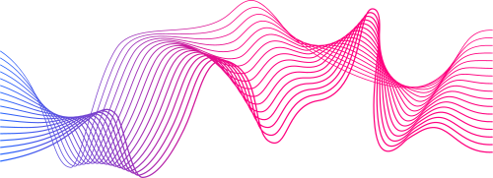
Practice School 1
BITS Pilani
PROJECT PRESENTATION
IMPLEMENTING MACHINE LEARNING ALGORITHMS AND UNDERSTANDING THEIR INFERENCES USING EXPLAINABLE AI
DEEPA. N (2021B4A73132H)
NIMISH BANSAL (2021B5A71179P)

Slide 2

CHAPTER-1
IMPLEMENTATION OF MACHINE LEARNING ALGORITHMS AND EXPLAINING THEM USING XAI

Slide 3

BITS Pilani
CONTENTS
1
About the Project
2
ML Algorithms
3
XAI Algorithms

Slide 4
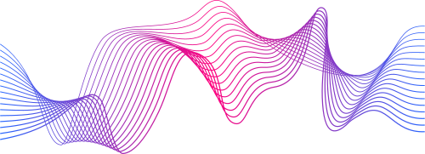
ABOUT THE PROJECT
BITS Pilani
To obtain the dataset from kaggle
To implement 5 machine learning algorithms - Decision Tree, Random Forest, Support Vector Machine, K - Nearest Neighbors, Naive Bayes
To explain the predictions using explainable AI algorithms - LIME, SHAP

Slide 5
MACHINE LEARNING CLASSIFIERS
RANDOM FOREST
BITS Pilani
DECISION TREE
SUPPORT VECTOR MACHINE
MACHINE LEARNING
NAIVE BAYES
K - NEAREST NEIGHBORS

Slide 6
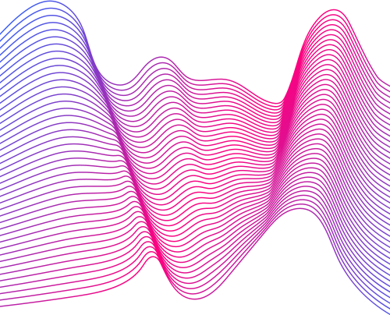
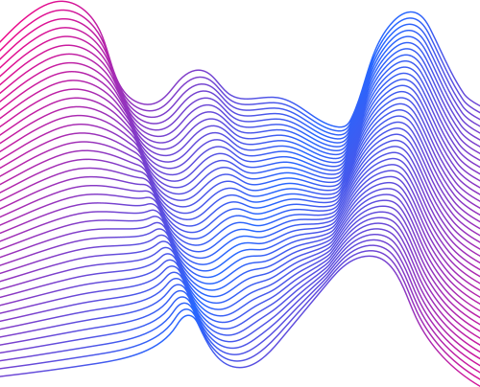
DECISION TREE
It is a flowchart-like tree structure.
Each decision node represents a feature, branches represents the decisions and the leaf nodes denote the result of the algorithm.
BITS Pilani
RANDOM FOREST
It is a supervised machine learning algorithm that is constructed from a collection of multiple decision tree algorithms.
It evaluates the decision tree and predicts the output based on majority.

Slide 7
SUPPORT VECTOR MACHINE
Objective is to find the hyperplane that maximizes the margin
Maximizing the margin leads to improved classificaton, structural stability, etc.
BITS Pilani
K - NEAREST NEIGHBORS
Objective is to find the k nearest neighbors using any distance metric.
Class label is assigned to the new data point based on the majority between the classes among the k neighbors.

Slide 8
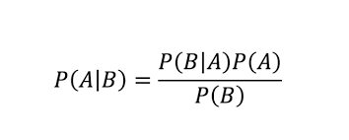
NAIVE BAYES
Objective is to find the posterior probability based on the Bayes Theorem.
It assumes that every feature is independent of the each other.
BITS Pilani

Slide 9
EXPLAINABLE AI ALGORITHMS
BITS Pilani
LIME
EXPLAINABLE AI
SHAP

Slide 10
LIME
LIME stands for Local Interpretable Model-agnostic Explanations.
It is a visualization technique that helps explain individual predictions.
BITS Pilani
SHAP
SHAP stands for Shapley Additive Explanations.
It aims to explain the prediction of an instance by computing the contribution of each feature to the prediction.

Slide 11
CHAPTER-2
OPTICAL CHARACTER RECOGNITION USING NEURAL NETWORKS

Slide 12
BITS Pilani
CONTENTS
1
About the Project
2
Neural Network
3
Optical Character Recognition

Slide 13
ABOUT THE PROJECT
BITS Pilani
To recognize any number from 0 to 9 when the input is in image format
To implement using FNN and CNN
To train and test the model using MNIST database
To calculate the test accuracy
To plot a graph between training and validation accuracy.

Slide 14
NEURAL NETWORK
BITS Pilani
FNN
NEURAL NETWORK
CNN

Slide 15
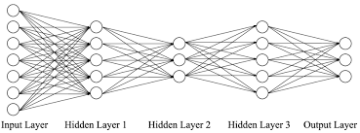
FEEDFORWARD NEURAL NETWORK
It consists of many layers having different number of neurons in each layer.
Each layer computes some pattern which helps in classifying the image.
The cost function is computed.
Back propagation is done to calculate the gradients.
Optimization algorithm such as Adam's optimizer is used to update the weights and biases.
BITS Pilani

Slide 16
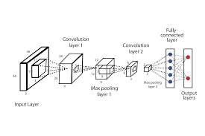
CONVOLUTIONAL NEURAL NETWORK
The data is given in the form of an image.
Different filters are used to identify patterns in the image.
It helps in exploring the depth of an image.
Hyperparameters such as padding, stride and filters can be optimized.
It is better than FNN as it helps to reduce the computation cost.
BITS Pilani

Slide 17
OPTICAL CHARACTER RECOGNITION
BITS Pilani
It is used to recognize any handwritten or printed text from a digital image.
CNN is more efficient than FNN for implementing OCR.
Softmax is used for multi-class classification.
Hyperparameter tuning

Slide 18
CONCLUSION
BITS Pilani
SVM outperformed all the ML models with a test accuracy of 91%
Naive Bayes was also quite successful with an accuracy of 83%
Random forest was better than Decision Tree
The predictions were explained better by LIME compared to SHAP
FNN trained much quickly compared to CNN
The training and test accuracy of CNN was greater than FNN

Slide 19
BITS Pilani
THANK YOU

